Slide 1
人工智能引论
宋睿华
中国人民大学高瓴人工智能学院

Slide 2
多模态与人工智能
造人：融合多模态信息的预测
造世界：有声视频的生成

Slide 3

EyEar: Learning Audio Synchronized Human Gaze Trajectory based on Physics-informed Dynamics
Xiaochuan Liu, Xin Cheng, Yuchong Sun, Xiaoxue Wu, Ruihua Song, Hao Sun, Denghao Zhang
AAAI 2025

Slide 4


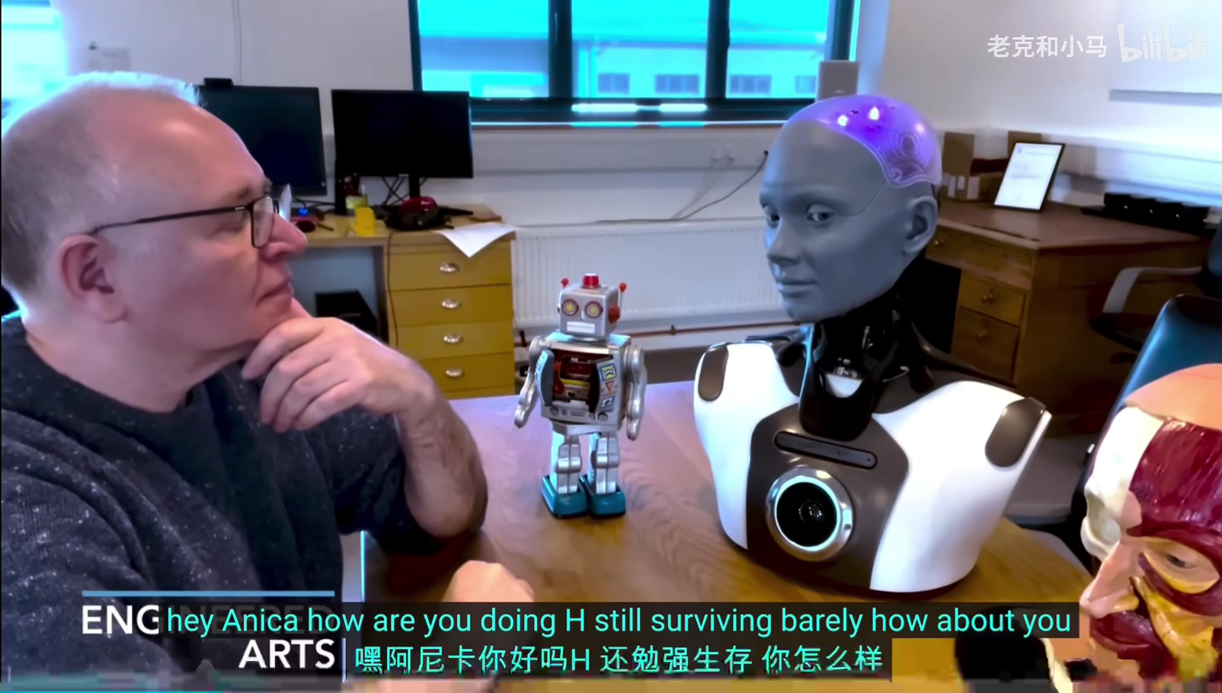
研究背景
数字人 / 类人机器人 虽然在动作上已经和人类十分相像，但它们的眼神仍然是呆滞的，通常只是以一些事先设计好的方式移动。这导致它们无法与人进行灵活的眼神交流，也无法对周围环境做出自然反应。

Slide 5
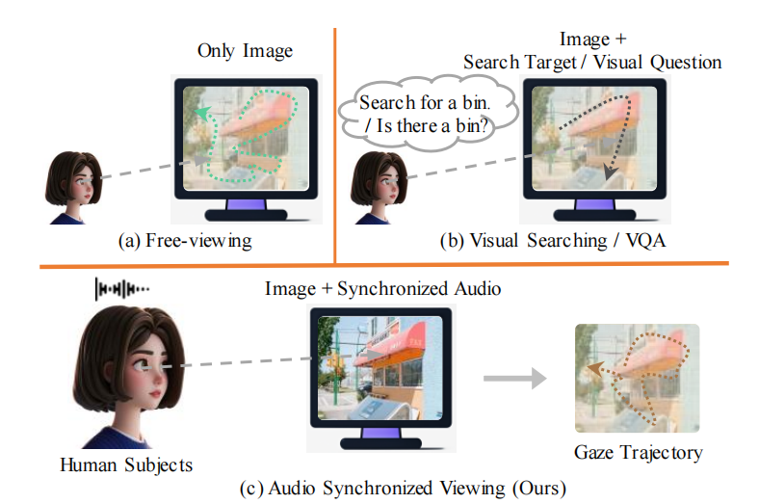
研究背景
之前关于人眼运动的研究场景主要可以分为三类：
Free-viewing (Viewing images / webpages);
Visual Searching;
Visual Question Answering;
现有的任务侧重于以视觉为中心的场景，但这些场景与现实生活场景相距甚远；
人眼运动受到诸多因素的影响，例如视觉刺激、听觉刺激、触觉刺激、内心想法、身体状态（疲劳或放松）等等；
为了弥补这一差距，我们提出了一个新的任务——Audio Synchronized Viewing。

Slide 6
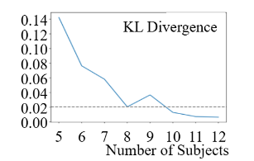
新的数据集——EyEar-20k
图像：从 Unsplash.com 网站上人工选择。为了更准确地反映现实生活场景，我们选择了人们在日常生活中可能遇到的图像，并且要求所选图像包含丰富的细节。分辨率：1024*1024。
音频：与图像具有语义关联（自动 Image Caption + 人工修改 + TTS）
受试者数量：基于分布的稳定性确定，最终选择 8 位；
受试者指示：被指示保持最自然的状态；

Slide 7
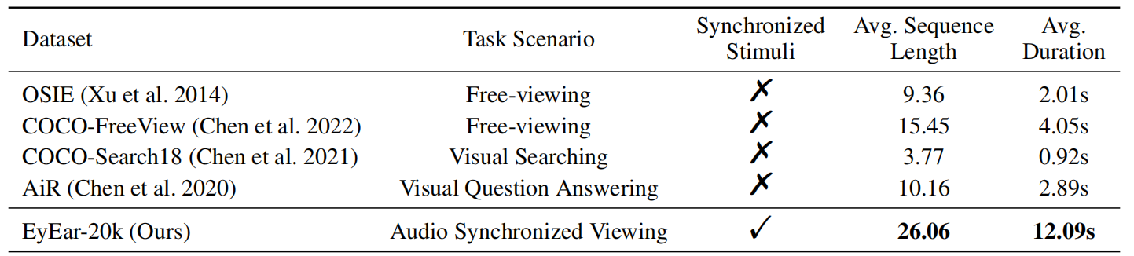
新的数据集——EyEar-20k
其他细节
投影尺寸：0.2 m × 0.2 m；
人眼与屏幕间距：0.5 m；
在音频开始前添加 5 秒的空白音频，让受试者熟悉图像；
设备：Eyelink Portable；

Slide 8
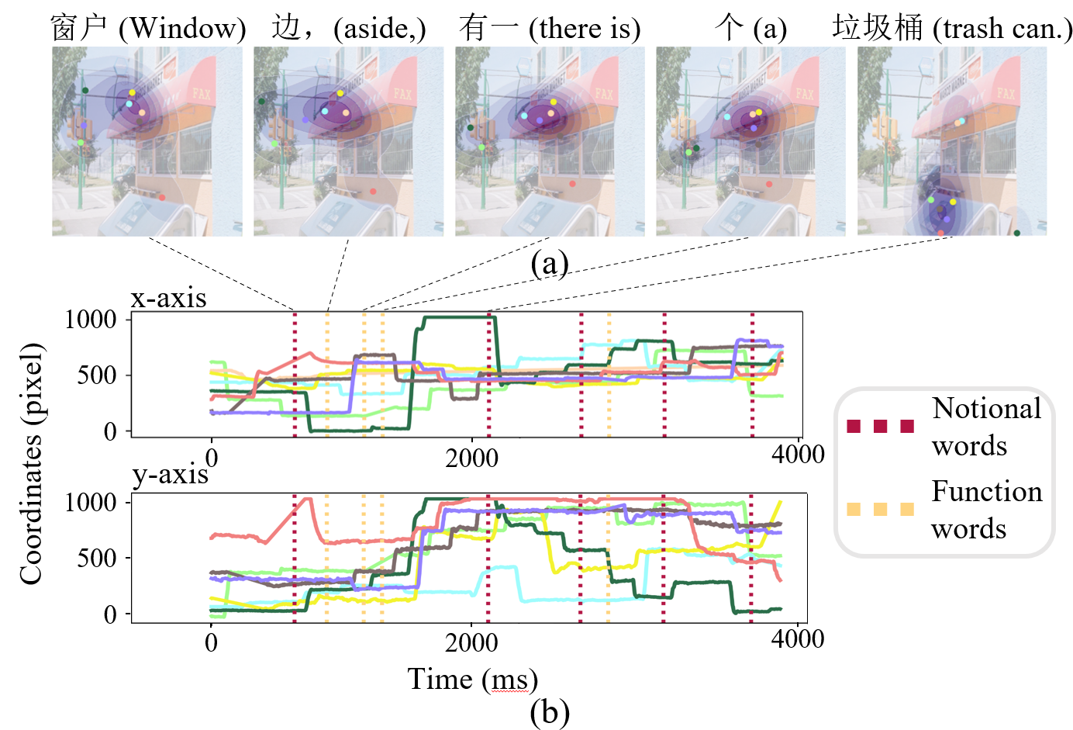
任务挑战
在多模态场景中有效地整合音频信息，同时考虑眼球运动的物理特征；
不同的个体具有完全不同的注视轨迹，数据个体差异性很高，对训练的稳定性提出了挑战。

Slide 9
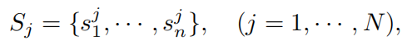
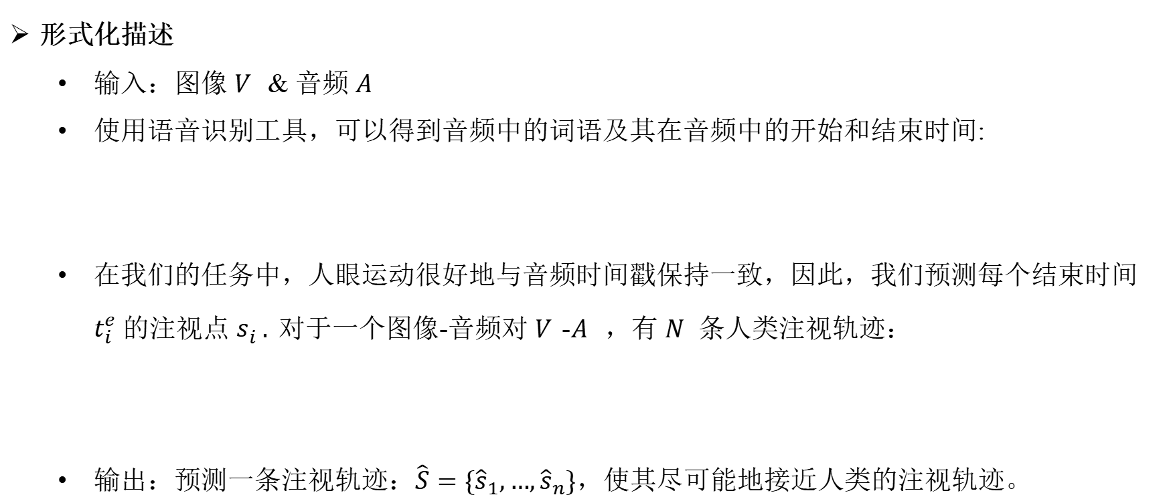
形式化描述
输入：图像 𝑉 & 音频 𝐴
使用语音识别工具，可以得到音频中的词语及其在音频中的开始和结束时间:
在我们的任务中，人眼运动很好地与音频时间戳保持一致，因此，我们预测每个结束时间 $t_{i}^{e}$ 的注视点 $s_{i}^{ } .$对于一个图像-音频对 𝑉-𝐴 ，有 𝑁 条人类注视轨迹：
输出：预测一条注视轨迹：$\hat{S}=\{{\hat{s}}_{1},…,{\hat{s}}_{n}\}$，使其尽可能地接近人类的注视轨迹。

Slide 10
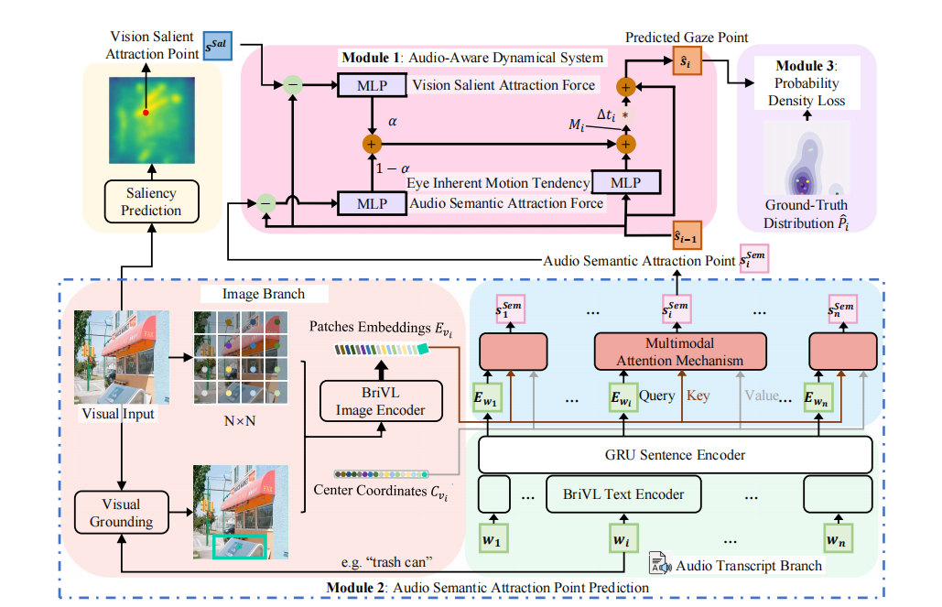
模型架构：动力系统 + 视觉分支 + 音频分支；基于概率分布的损失函数

Slide 11
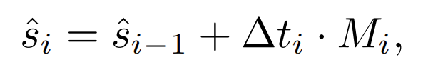
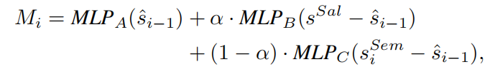
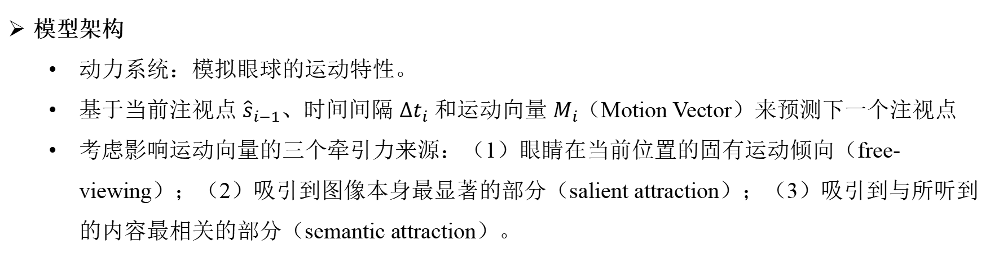
模型架构
动力系统：模拟眼球的运动特性。
基于当前注视点 ${\hat{s}}_{i−1}$、时间间隔 $Δt_{i}$ 和运动向量 $M_{i}$（Motion Vector）来预测下一个注视点
考虑影响运动向量的三个牵引力来源：（1）眼睛在当前位置的固有运动倾向（free-viewing）；（2）吸引到图像本身最显著的部分（salient attraction）；（3）吸引到与所听到的内容最相关的部分（semantic attraction）。
（1）
（2）
（3）

Slide 12
模型架构
视觉分支 + 音频分支：获得语义吸引点。

Slide 13
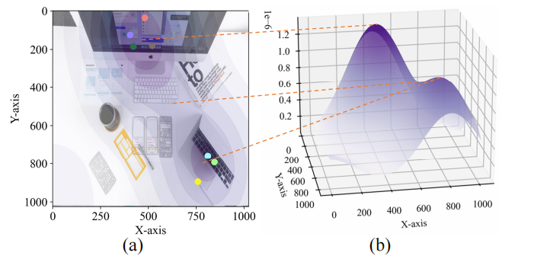
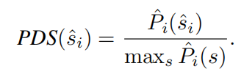
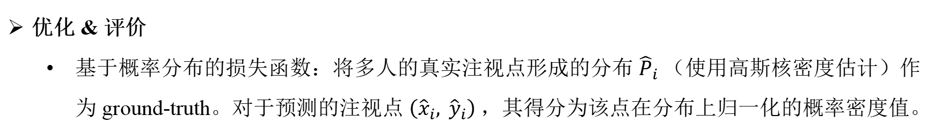
优化 & 评价
基于概率分布的损失函数：将多人的真实注视点形成的分布 ${\hat{P}}_{i}$（使用高斯核密度估计）作为 ground-truth。对于预测的注视点 $\left({\hat{x}}_{i}, {\hat{y}}_{i}\right)$，其得分为该点在分布上归一化的概率密度值。

Slide 14
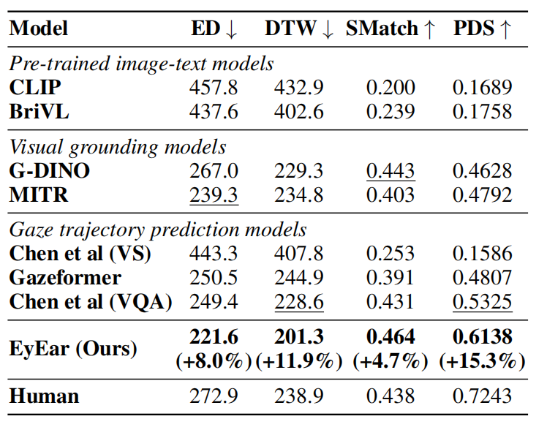
实验结果
（1）EyEar 在所有指标中始终优于所有 baselines，在不同的指标上，对最佳 baseline 的改进从 4% 到 15% ；
（2）提出的基于概率分布的得分（损失）函数是最合理的评价方法，在四个指标中具有最好的鉴别能力；
（3）性能上：Pre-trained image-text models << Visual grounding models < Gaze trajectory prediction models.

Slide 15
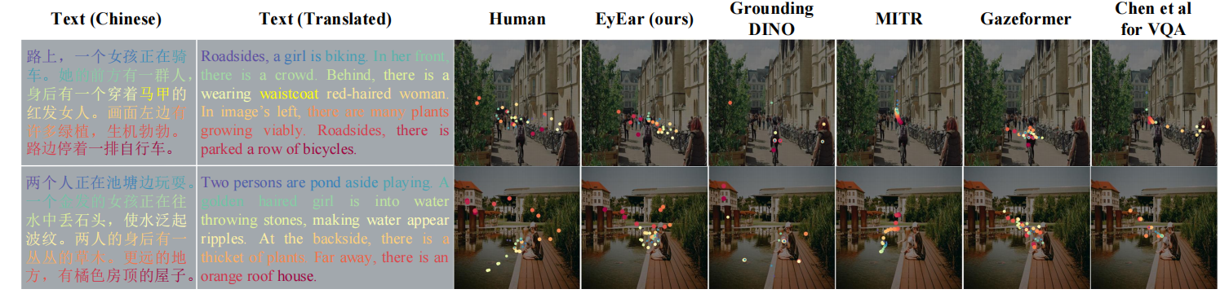
实验结果

Slide 16
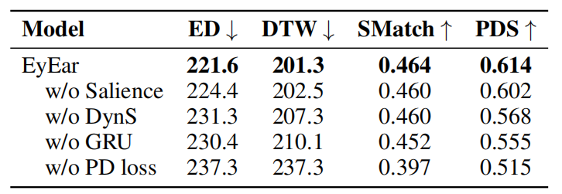
实验结果——消融实验
消融任何部分都会导致所有指标的性能下降；
不使用概率密度损失函数（PD loss）会在所有指标上一致地产生最大的性能下降；
去除 Saliency 的影响最小，说明在我们的场景中，注视轨迹主要受听觉刺激的影响。

Slide 17
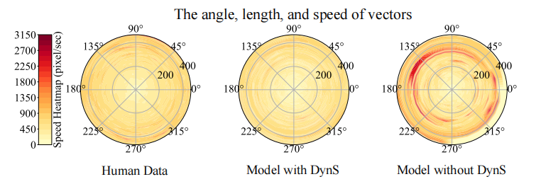
实验结果——消融实验
动力系统——更好地模仿眼睛的运动特征。

Slide 18
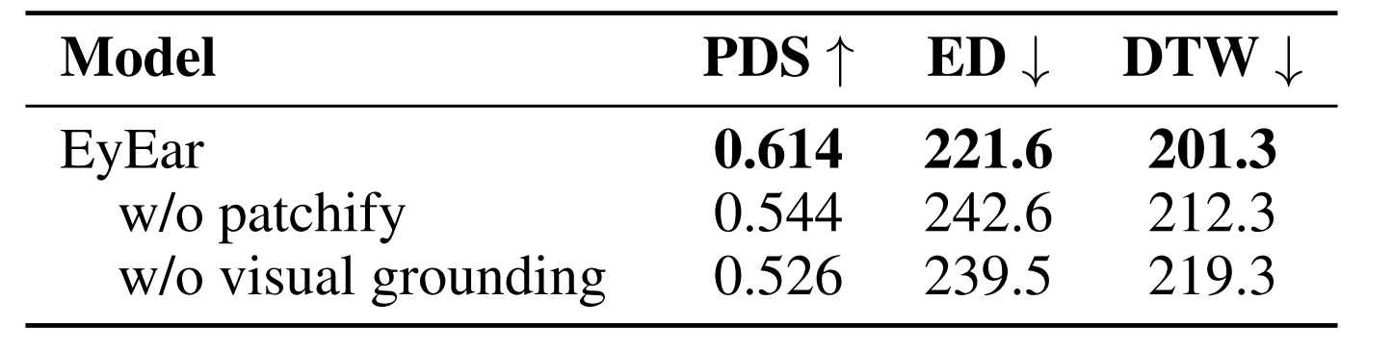
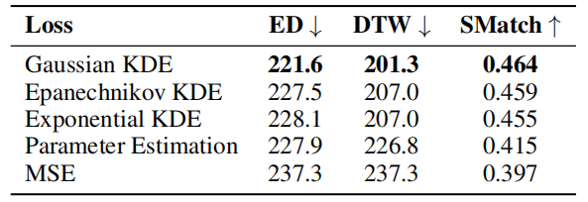
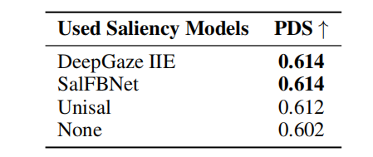
实验结果——消融实验
不同的图像信息； 不同的基于概率分布的损失；
不同的显著性预测模型；

Slide 19
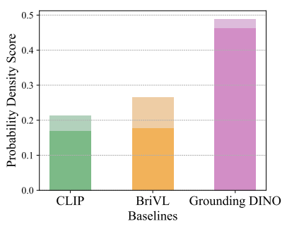
实验结果
动力系统的即插即用性；

Slide 20
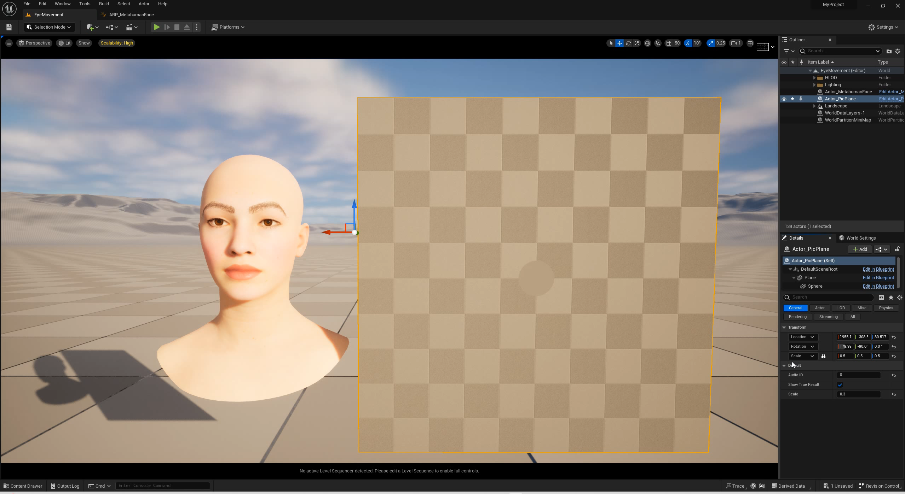
应用

Slide 21
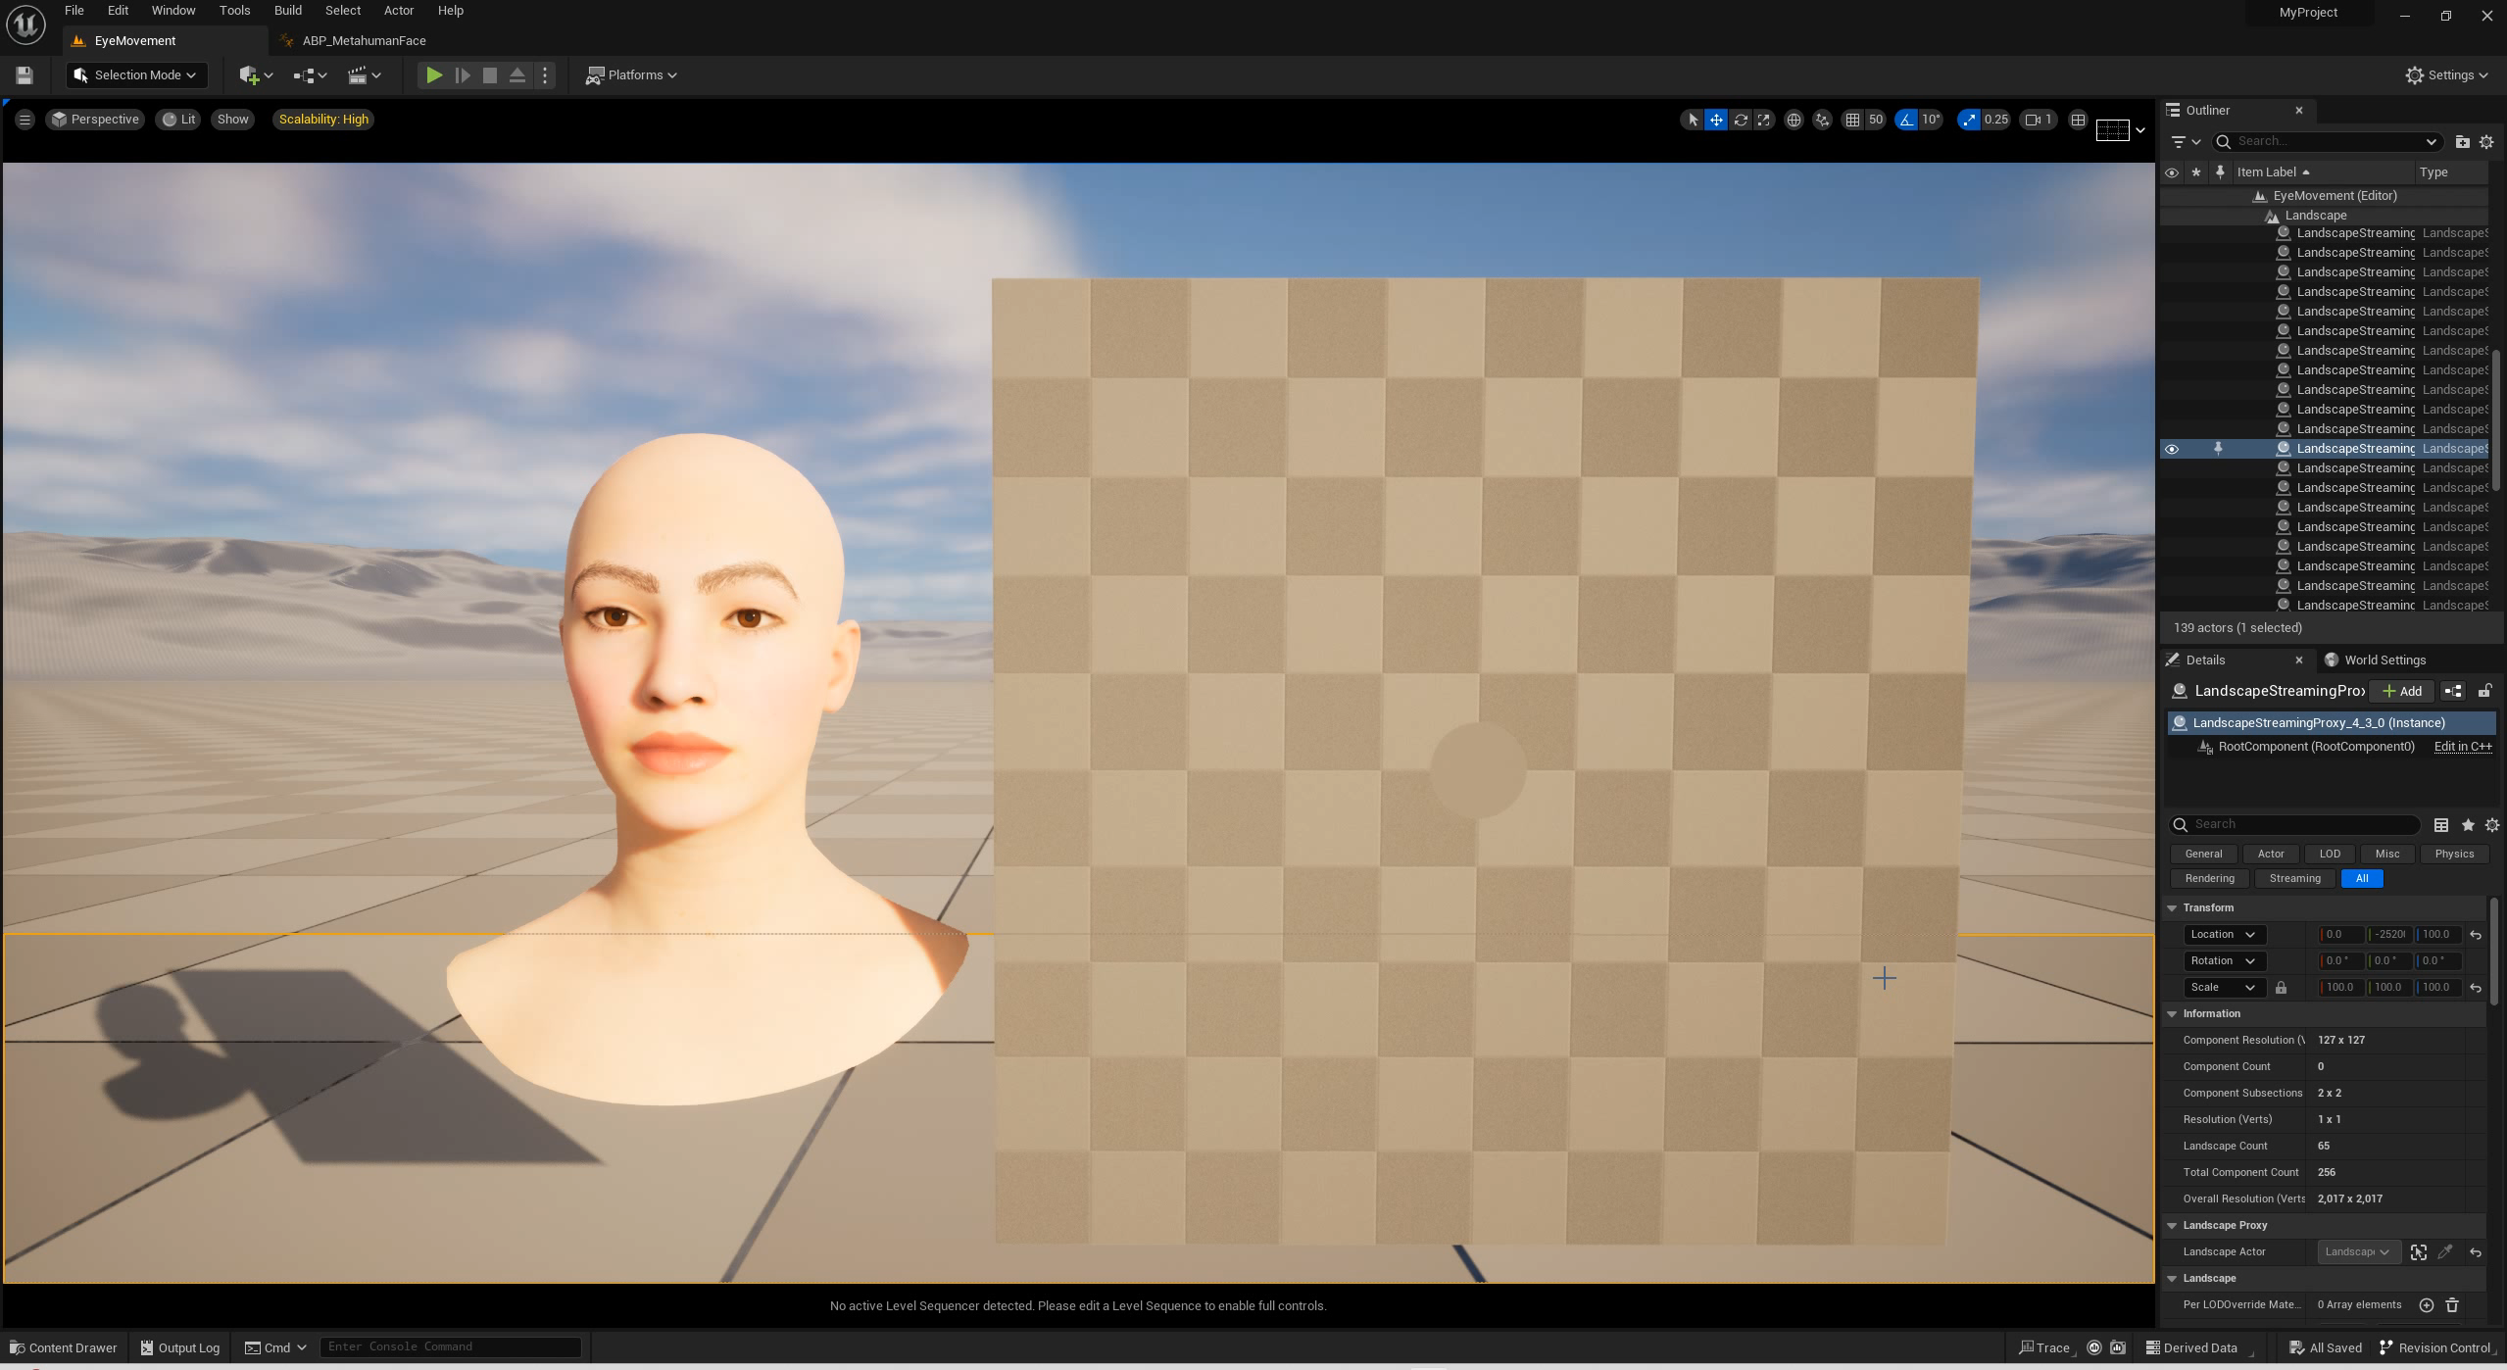
应用

Slide 22
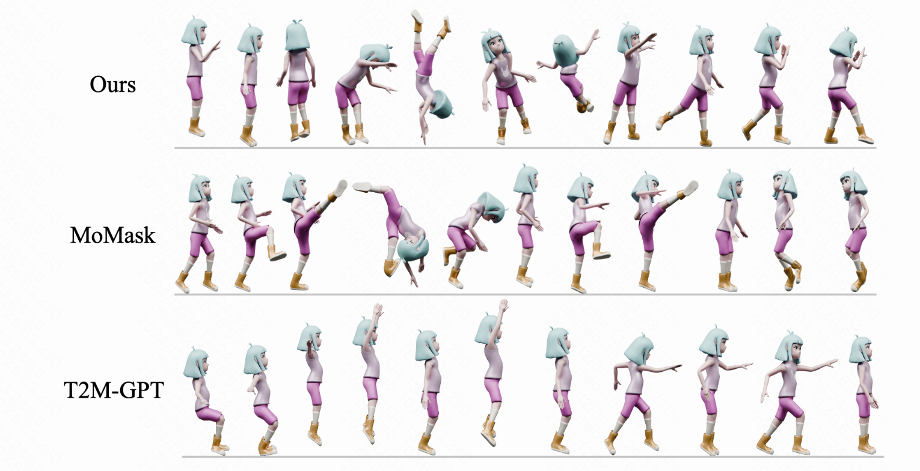
文本到动作序列生成
A person began jumping rope, then spun around twice and did a handstand. After that, this person somersaults forward and balances on one leg, then throws a punch and dodges a kick.
CoMo数字人动作生成大模型

Slide 23
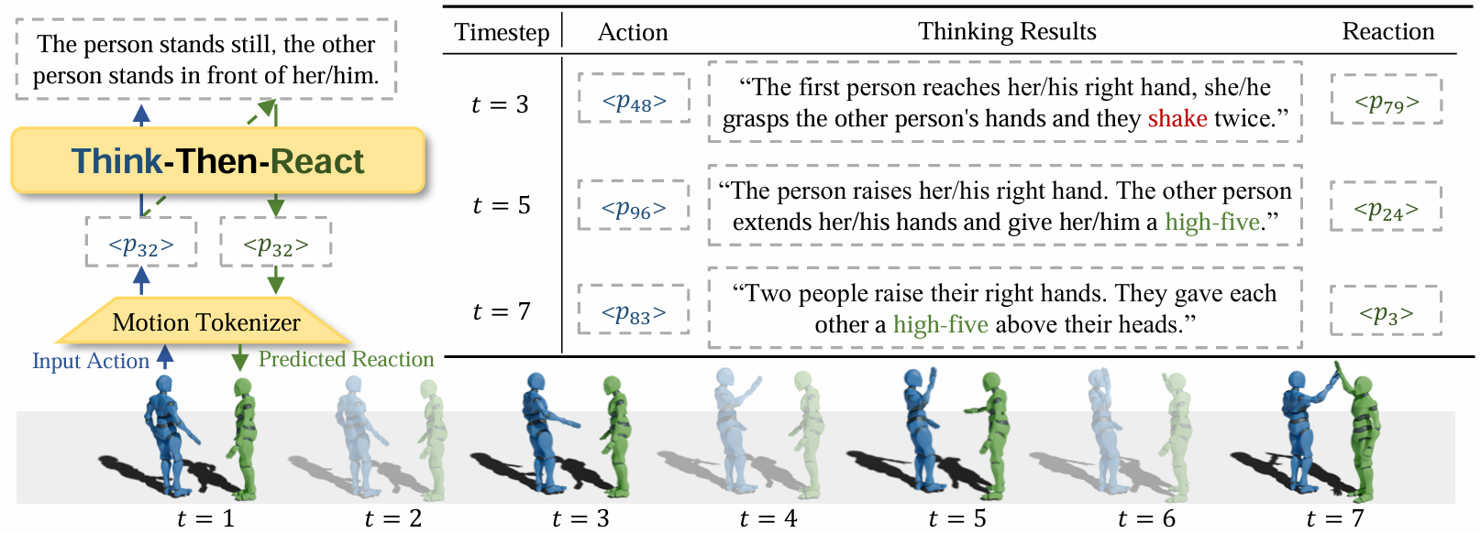
根据一个人的动作做出另一个人的反应动作
Think-Then-React: Towards Better Action-to-Reaction Motion Generation

Slide 24
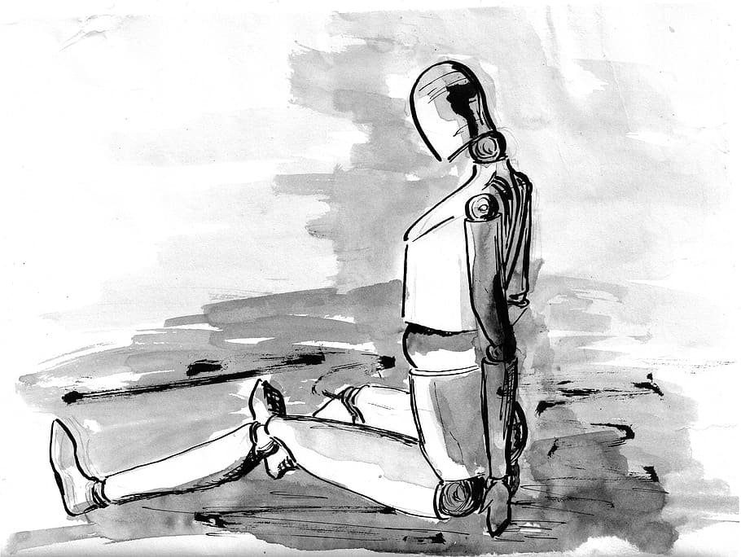
模拟思维
人工智能创作
搜索与下棋
逻辑定理证明
模拟视觉感官
计算机视觉
计算机图形学
模拟融合
多模态的感知
多模态的预测
多模态的表达
模拟理解
自然语言处理
机器翻译
搜索引擎
推荐系统
对话系统
模拟声学感官
语音识别
语音合成
模拟行为
机器人
强化学习

Slide 25

人工智能的目标已不只是造人，还要造世界

Slide 26





TiVA: Time-aligned Video-to-Audio Generation
Authors: Xihua Wang*¹, Yuyue Wang*¹, Yihan Wu*¹, Ruihua Song^{✉️ 1}, Xu Tan ^{✉️2}, Zehua Chen ³, Hongteng Xu ¹, Guodong Sui ⁴ Institutions: ¹ Renmin University of China, ² Microsoft, ³ Tsinghua University, ⁴ ZHI-TECH GROUP Speaker: Xihua Wang Email: xihuaw@ruc.edu.cn
Notes:
Hello everyone, I am Wang Xihua from Renmin University of China. Today, I am delighted to share with you our work in the field of multimodal generation: TiVA: time-aligned video-to-audio generation. As the title suggests, our focus is on foley silent videos and primarily addressing the issue of time synchronization.

Slide 27
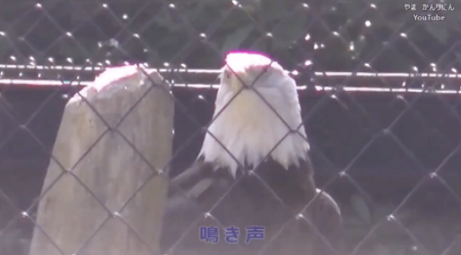
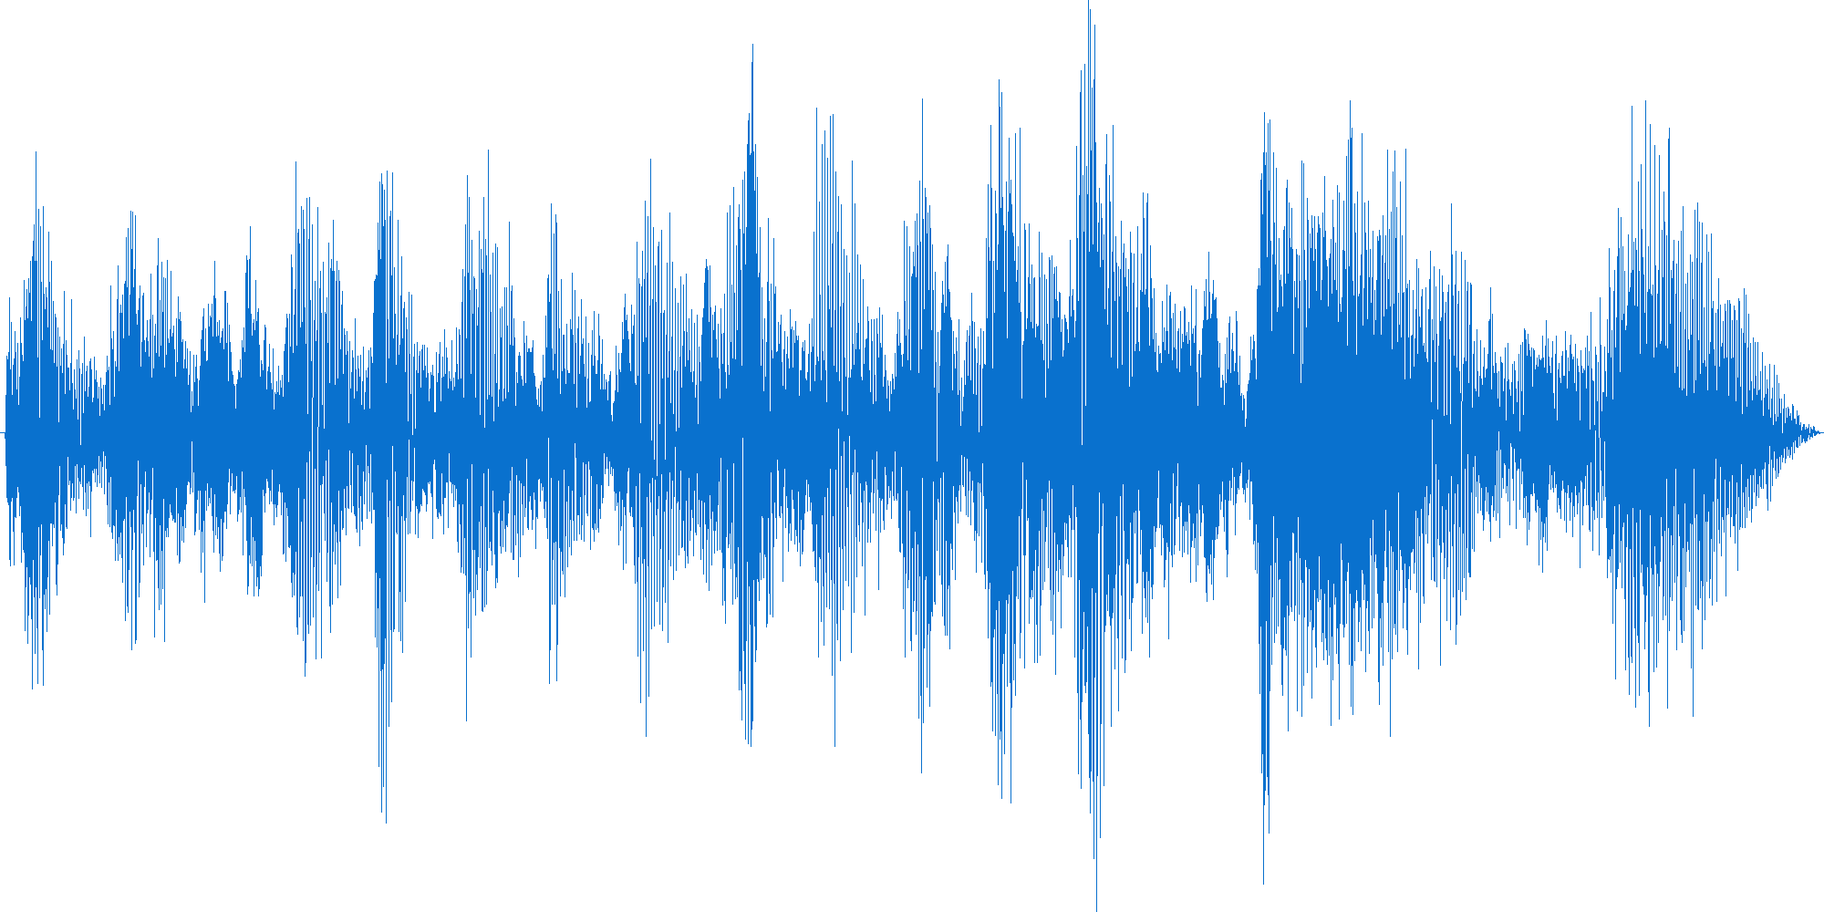
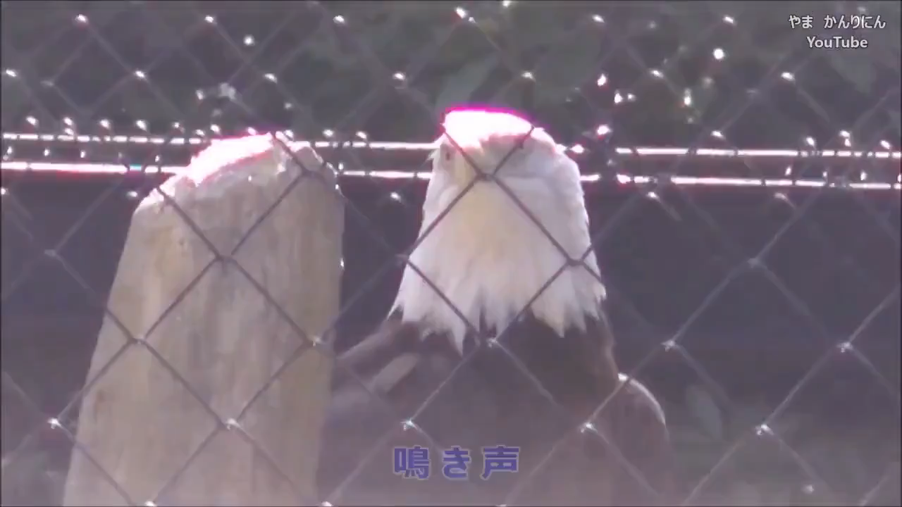
Background of video-to-audio (V2A) generation
Target: Generate a semantically aligned and time-synchronized sound for a silent video.
Key Challenge: semantical alignment & time synchronization
V2A Model
Video (Eagle screaming)
Audio (Eagle screaming)
Input silent video
Previous work
Our work (TiVA)
Notes:
Let's begin with some background on video-to-audio (V2A) generation. The main goal of V2A is to input a silent video clip and have the model output sound that matches it.
The community has made some progress in V2A, but there are still some challenges. Let's look at this example: On the left is an input video clip of an eagle in a zoo, which is silent at first and then it screams three times. To generate a realistic sound, it's not only necessary for the sound to semantically correspond to this eagle, but also to be synchronized with the mouth movement. This is not easy.
As you can see from the result of the best baseline method, it can generate some bird calls that match the video semantics, but it does not synchronize with the eagle's mouth movement. Previous related work mainly focused on semantic alignment, for instance, generating a cat's meow when inputting cat videos, a dog's bark when there’s a dog, and a bird's chirp when a bird is there. However, they didn't solve the problem of time synchronization well.
Our work focuses on addressing this issue. On the right is the effect of our work, TiVA. As you can see, our model remains quiet at the beginning, and when the eagle's mouth is opening it generates sound synchronized with the video. However, even though it is roughly synchronized, the generated sound still has a slight delay, indicating that generating synchronized audio based solely on video is indeed a difficult problem.

Slide 28
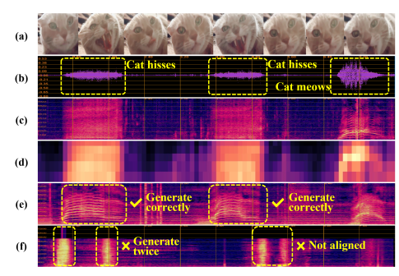
Our solution for time-aligned V2A
If it’s difficult to do generation in one step, do it in steps!
Our solution is a coarse-to-fine approach
input video frames
Difficult!
ground truth waveform
ground Mel-spectrogram
Notes:
Next, let's look at our solution to the problem of time synchronization.
After various explorations, we finally found a method to generate audio from coarse to fine. To give an example, in this video, the cat opens its mouth three times. The first two times, it makes a ”ao" sound when it is frightened, and its mouth opens wide; the last time, it calms down and makes a "meow" sound, with its mouth smaller.
Some differences can be seen from the waveform in the second row. Normally, when we generate sound, we choose to directly generate the Mel spectrogram of the sound, and then a pre-trained vocoder is used to generate the final sound. The Mel spectrogram can serve as the target for V2A, as shown in the third row.
As we saw in the previous example, we found that it's hard for a model to learn a mapping to the Mel spectrogram directly from the video, or to learn the conditional distribution of the accurate Mel spectrogram based on the video's conditions. It often loses time synchronization.

Slide 29
Our solution for time-aligned V2A
If it’s difficult to do generation in one step, do it in steps!
Our solution is a coarse-to-fine approach
input video frames
Difficult!
ground truth waveform
ground Mel-spectrogram
Easier!!
low-resolution Mel-spectrogram
Audio Layout
TiVA (ours)
baseline
Notes:
Our core insight for this problem is: if it's hard to do it in one step, let's do it in multiple steps! If it's hard for the model to learn video-to-audio directly, then we find an appropriate intermediate state, first to this intermediate state and then to audio. We found that the low-resolution Mel spectrogram can serve as this intermediate state.
Although its resolution is reduced, it fully retains the information of time synchronization, such as when these three calls should start and end. It even retains rough texture information, which can correspond to semantics.
We call this low-resolution Mel spectrogram "Audio Layout".
Finally, we start with the video, first generate the audio layout, and then generate the final audio. As you can see, taking this path can indeed achieve better synchronization effects, compared to our baseline method.

Slide 30
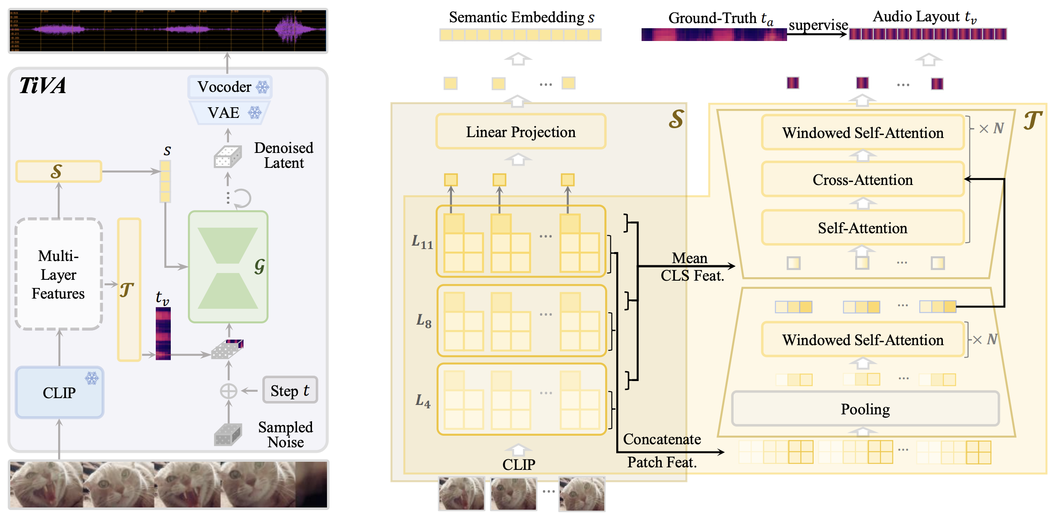
Details of our TiVA framework
TiVA framework
Semantic Encoder + Audio Layout Predictor + Conditional Generator
Notes:
Next, we show the architecture of our method in detail.
First, let's look at the left side, which is our overall architecture. Our framework has three sub-modules, Semantic Encoder S + Audio Layout Predictor T + Conditional Generator G. First, a video is inputted. The Semantic Encoder and Audio Layout Predictor extract/predict the semantic features of the video and the audio layout, respectively.
Then, the Conditional Generator generates time-synchronized and semantically matched audio based on the control signals of the semantic features and audio layout.
On the right is the detailed architecture of our Semantic Encoder S and Audio Layout Predictor T. We use CLIP to extract hierarchical video features for two parts' use. First, these are projected into the audio semantic space by a linear layer, which is our Semantic Encoder. Then, these features are fed into an encoder-decoder structure layout predictor to generate the audio layout.

Slide 31
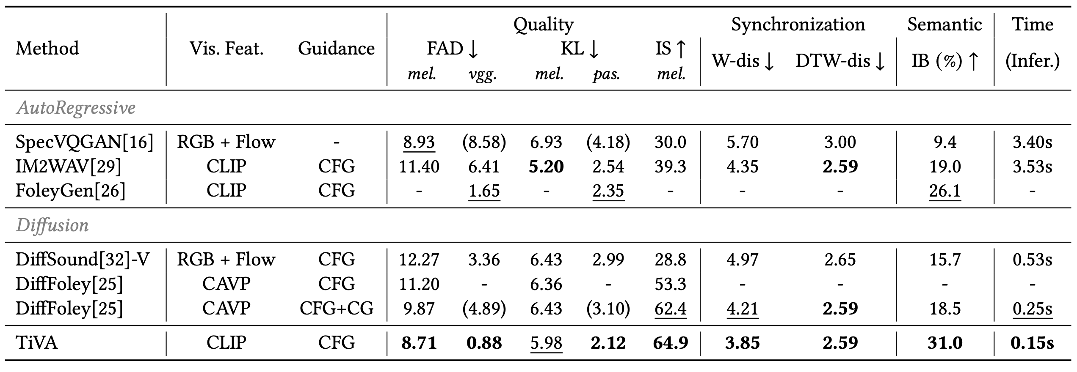
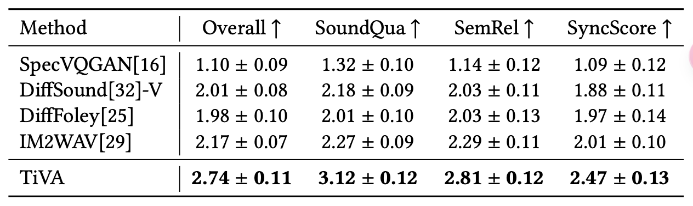
Performance of TiVA
VGGSound benchmark
Notes:
Now let's look at the experimental results of TiVA.
We can see that both automatic indicators and manual evaluation indicators have significantly improved compared to the baseline, regardless of sound quality, synchronization or semantic matching, also efficiency.
(dense) On the VGGSound dataset, we compared TiVA with various baseline methods, one group based on autoregression and another based on diffusion models. We also listed the models used to extract visual features. CAVP used audio in contrastive learning, while CLIP is a model that aligns pure visual and text. Even so, we achieved the best results on traditional quality indicators such as FAD, KL, and diversity indicator IS. We found that these evaluation indicators did not specifically consider the synchronization of audio and video, so we studied how to evaluate whether the generated audio is synchronized with the video, such as whether the cat's call corresponds to the mouth opening. Therefore, we proposed two new indicators, W-Distance and DTW-Distance. The main idea is that directly evaluating whether the video and generated audio are synchronized is as difficult as V2A, and it's not easy to get right. But the original video can serve as Groundtruth. If we regard audio as a distribution, we can use the minimum cost to measure the change from one distribution to another to measure how similar they are. DTW and W distance are two methods that meet the requirements. In addition, according to the automatic semantic matching indicator based on ImageBind (IB), we far exceeded the baseline methods. The ultimate evaluation of the generation effect is still manual evaluation. Although the cost is high, we can only randomly select 50 samples for this experiment, which is still the most reliable feedback. According to the manual evaluation indicators, we can see that TiVA scored the highest, whether it's the overall score, sound quality, relevance to the picture, or synchronization score. We also found that among the baseline methods, although according to the automatic indicator FAD, the IM2WAV method seems to be lower than DiffFoley, the manual evaluation results show that the effect of IM2WAV is better. Looking back at the results of the automatic indicators, we can gain some insights into which indicators are more reliable. FAD is an evaluation based on data distribution at the stage of poor generation quality. Now that the generation quality has greatly improved, it basically cannot distinguish the good and bad details of the results, and it may even mislead researchers. I believe researchers in video generation and action sequence generation can relate to this.

Slide 32
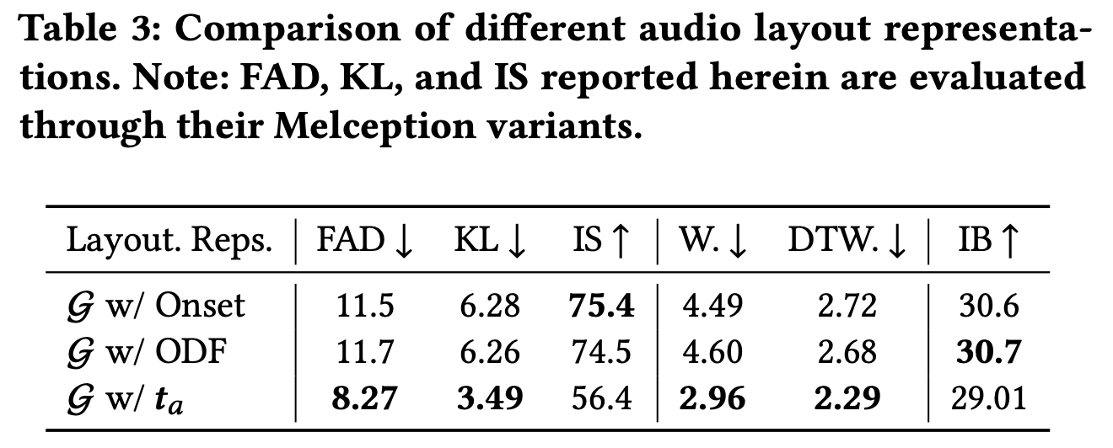
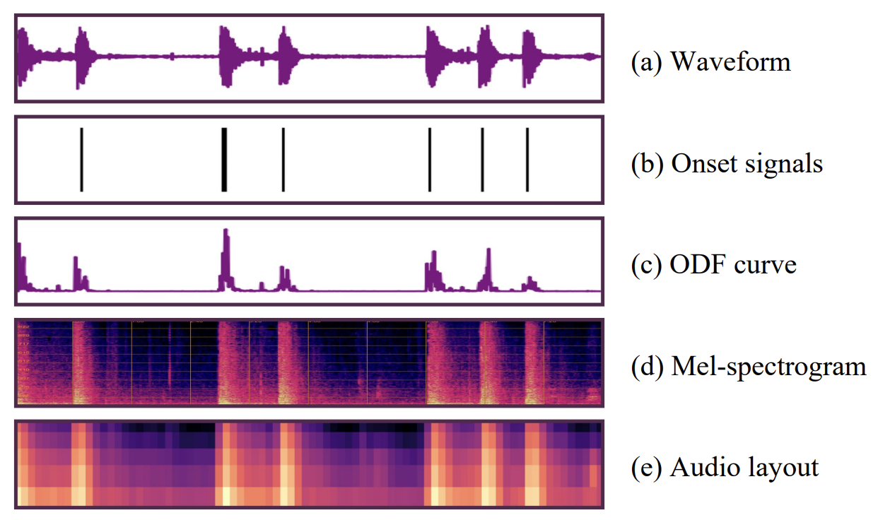
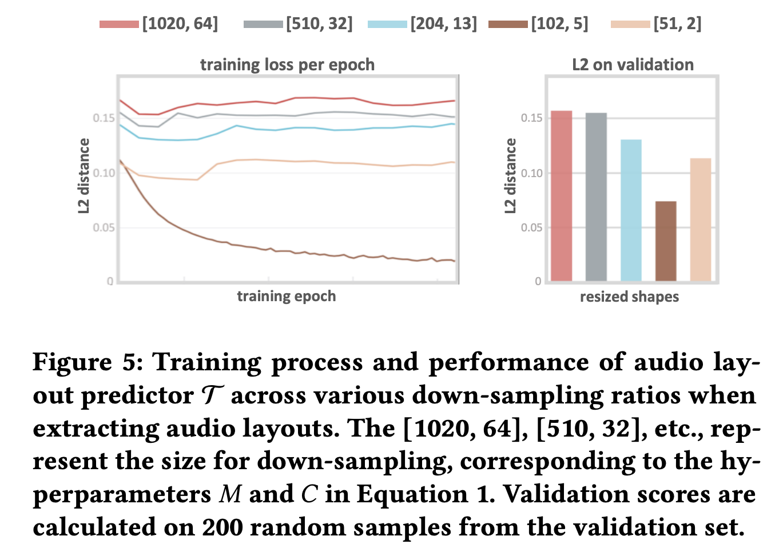
Study on audio layout representation
For controllability: Onset? ODF? Audio Layout?
Representations of audio signal
For Audio Layout: What resolution?
Notes:
The most innovative part of TiVA is the prediction of the audio layout before generating the final result.
Besides our low-resolution Mel audio layout, the Onset, a 0/1 discrete signal, and the ODF curve, a continuous one-dimensional curve, can serve as forms of the audio layout. We find that this audio layout not only carries rhythm information but also retains semantic information, corresponding to the texture and brightness changes of the Mel spectrogram. Therefore, it provides more detailed guidance for the generator.
In addition, what is the best resolution for using low-resolution Mel as the audio layout? If the resolution is too high, it will be difficult to learn directly from the video; if the resolution is too low, it will not be of much use to the generation.
(dense) Strictly speaking, not only can the low-resolution Mel spectrogram serve as the audio layout, but we also have other options. The figure shows several forms of audio signals. Both the Onset, a 0/1 discrete signal, and the ODF curve, a continuous one-dimensional curve, can serve as forms of the audio layout. Therefore, we also tested the effect of using them as the audio layout. Indeed, the low-resolution Mel spectrogram we proposed is the best. We analyzed that this audio layout not only carries rhythm information but also retains semantic information, corresponding to the texture and brightness changes of the Mel spectrogram. Therefore, it provides more detailed guidance for the generator. In addition, what is the best resolution for using low-resolution Mel as the audio layout? We compared different resolutions, with the highest being the original resolution of 102064, and the lowest being 512. The best resolution is 102*5, which is basically compressed to 1/10 in both the time dimension and the frequency dimension. If the resolution is too high, it will be difficult to learn directly from the video; if the resolution is too low, it will not be of much use to the generation.

Slide 33
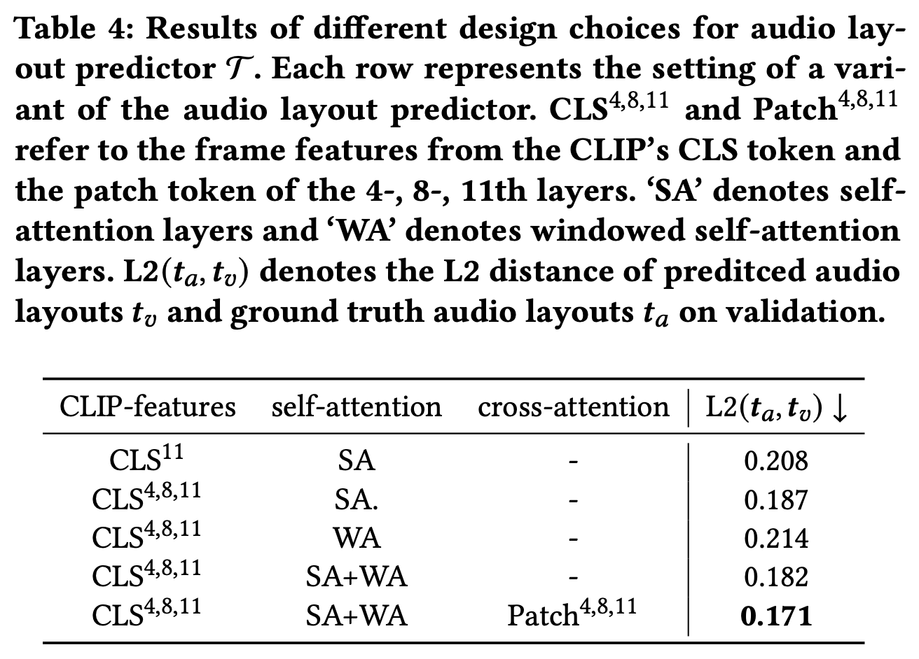
Study on audio layout predictor
Design choices for Audio Layout predictor:
Notes:
We also studied the structure of the predictor that predicts the audio layout. The right table shows the necessity of specific model design observed through experiments.
It can be seen that using multi-layer CLIP CLS features can reduce the learning loss, using only self-attention or windowed self-attention is not as good as using them together; on the basis of high-level information CLS, adding low-level Patch features can reduce the learning loss.
That is, there are no redundant modules in our design.

Slide 34
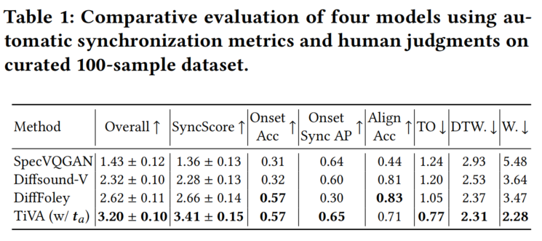
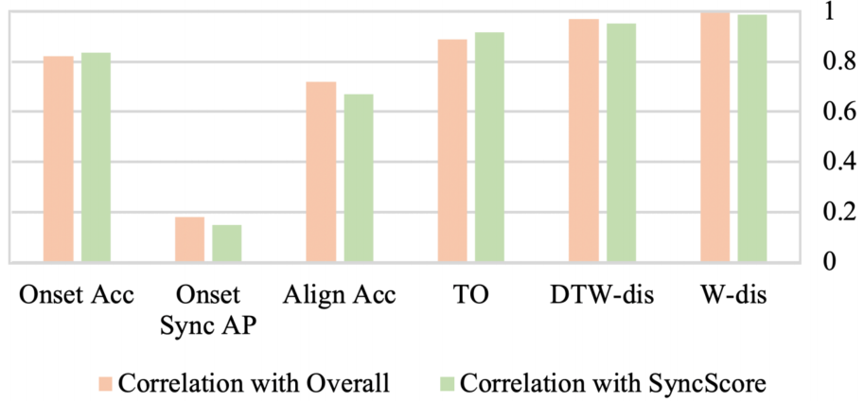
Study on synchronization metrics
Representations of audio signal → synchronization metrics
Align Acc, Temporal Offset (TO)
Onset accuracy (Onset Acc), average precision (Onset AP)
DTW-distance, W-distance
Notes:
We also studied the structure of the predictor that predicts the audio layout. The right table shows the necessity of specific model design observed through experiments.
It can be seen that using multi-layer CLIP CLS features can reduce the learning loss, using only self-attention or windowed self-attention is not as good as using them together; on the basis of high-level information CLS, adding low-level Patch features can reduce the learning loss.
That is, there are no redundant modules in our design.

Slide 35
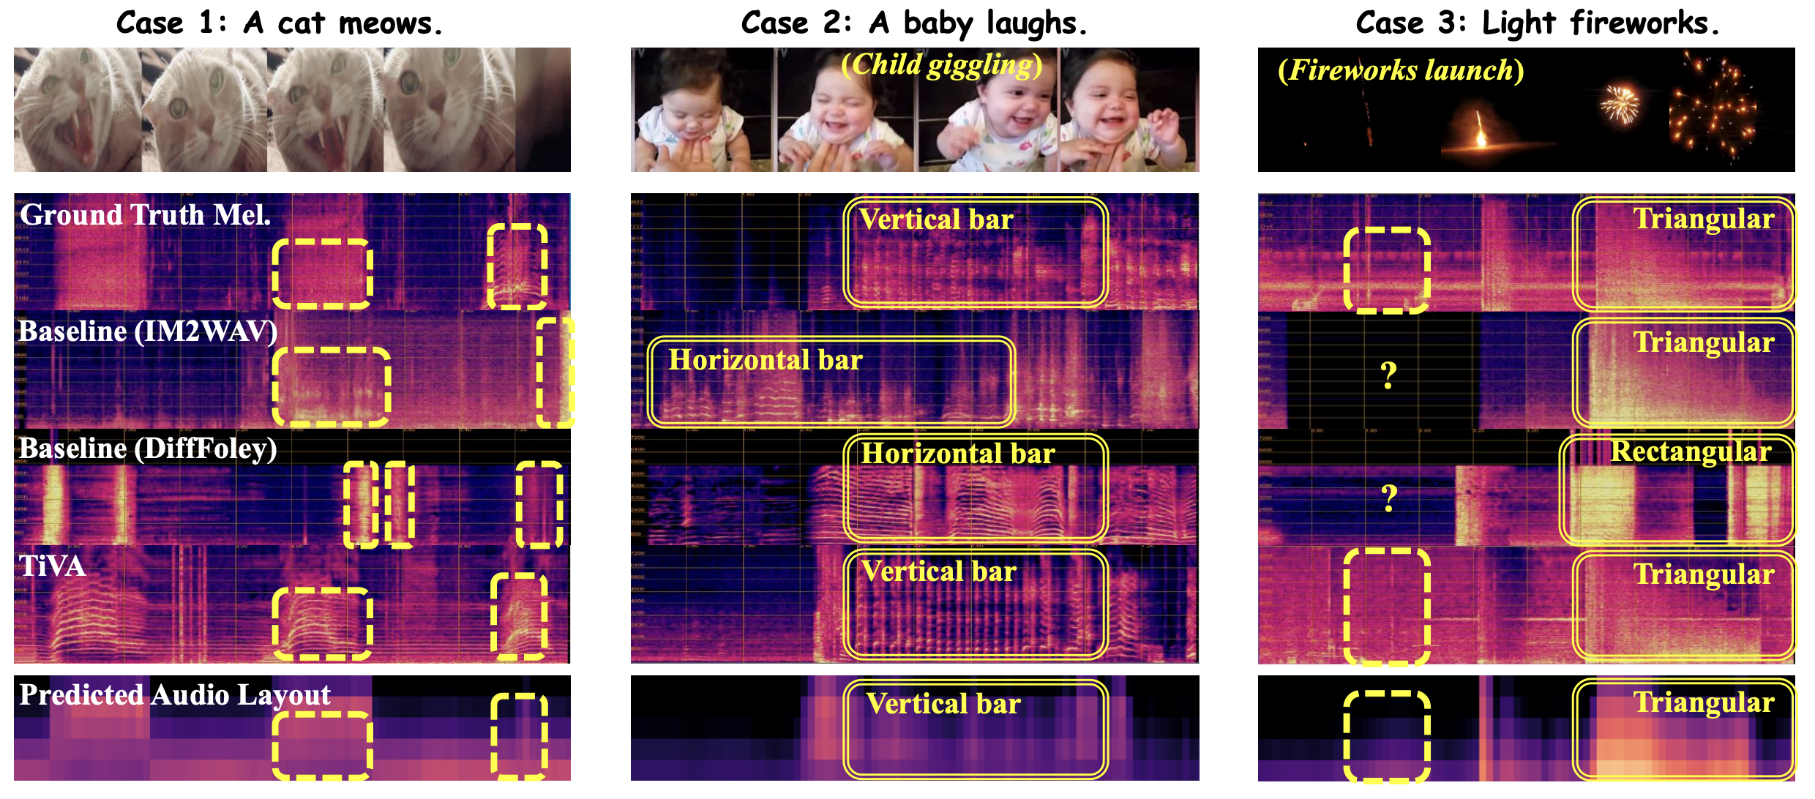
Case study on VGGSound benchmark
Notes:
Finally, we provide more examples.
The second example is a child giggling. This particular laughter, reflected in the Mel spectrogram, would observe dense vertical stripes. We found that although our predicted audio layout is relatively vague, the texture of the result generated by TiVA is very similar to that of the original audio.
The third example is the process of a firework explosion. You can also observe a clear triangle on the Mel spectrogram. There are fewer and fewer high frequencies, and the low frequencies are relatively persistent. Both we and IM2WAV can generate such a pattern.

Slide 36
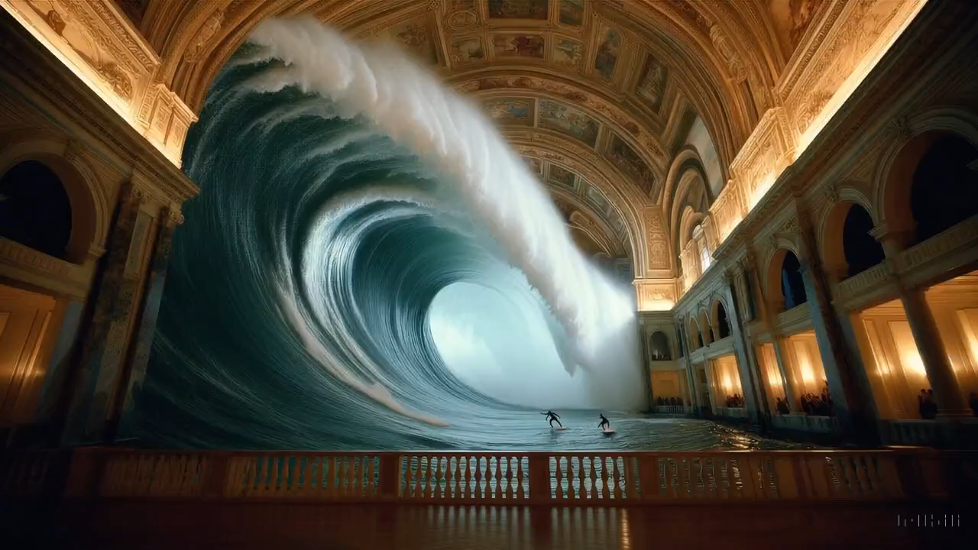
Case Study
7
Notes:
这里给大家播放一个为Sora公开的视频做配音的结果。大家可以看到随着大浪拍打向我们，声音很自然的在变化；最后一个想象的画面：人在滑板上飞了起来，配了一段类似直升机的声音，也有一定的合理性。

Slide 37
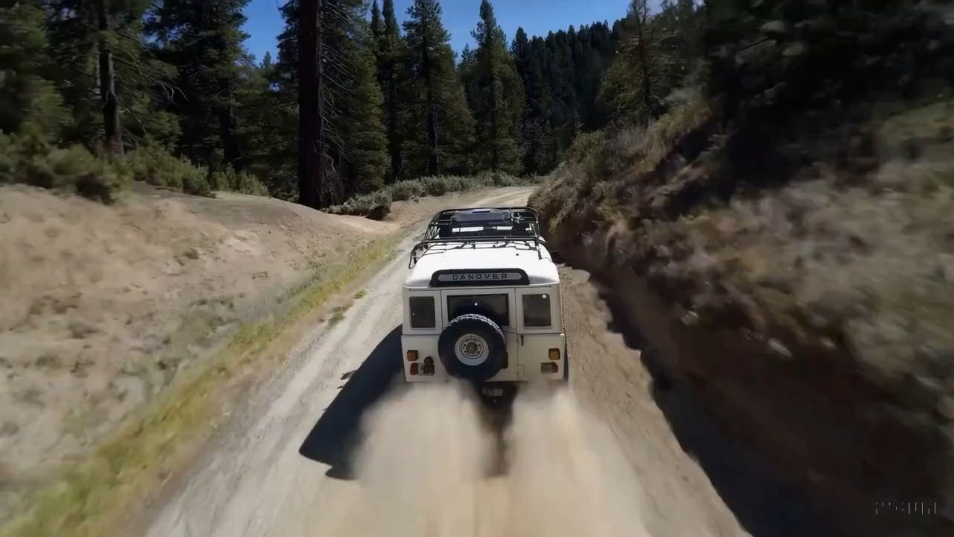
Case Study
7
Notes:
这里给大家播放一个为Sora公开的视频做配音的结果。大家可以看到随着大浪拍打向我们，声音很自然的在变化；最后一个想象的画面：人在滑板上飞了起来，配了一段类似直升机的声音，也有一定的合理性。

Slide 38

Case Study
7
Notes:
这里给大家播放一个为Sora公开的视频做配音的结果。大家可以看到随着大浪拍打向我们，声音很自然的在变化；最后一个想象的画面：人在滑板上飞了起来，配了一段类似直升机的声音，也有一定的合理性。

Slide 39
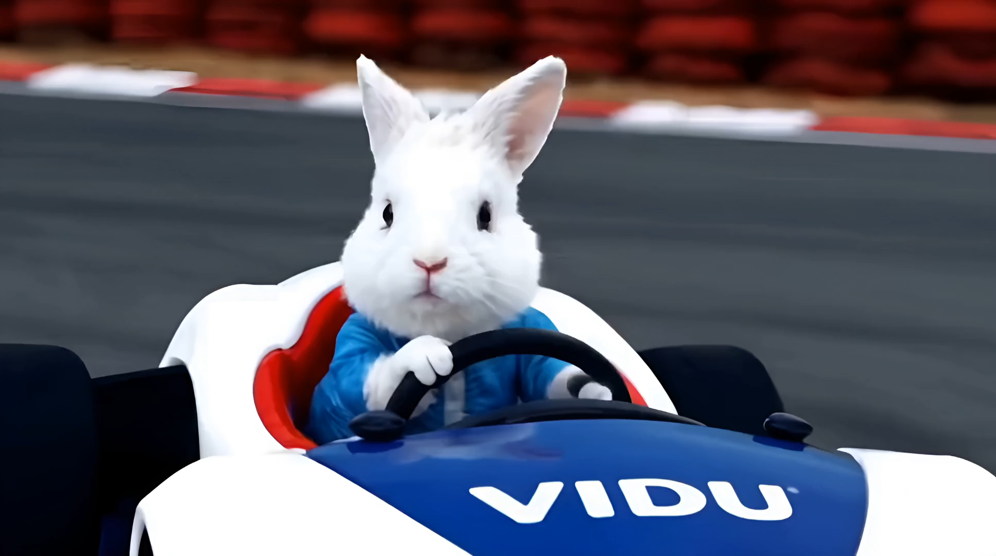

TiVA：Time-Aligned Video-to-Audio Generation
Wang X, et al. TiVA: Time-Aligned Video-to-Audio Generation, ACM MM 2024 (Oral).
7
Notes:
我们也为朱军老师用ViDU生成的小兔子开赛车生成了一段音频。效果如下。

Slide 40
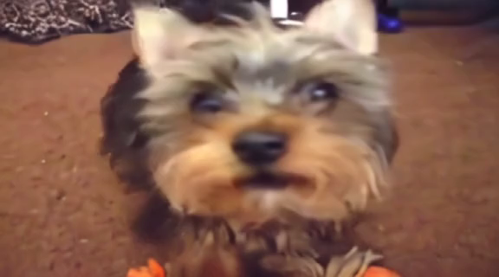
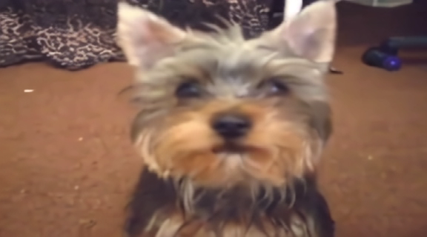
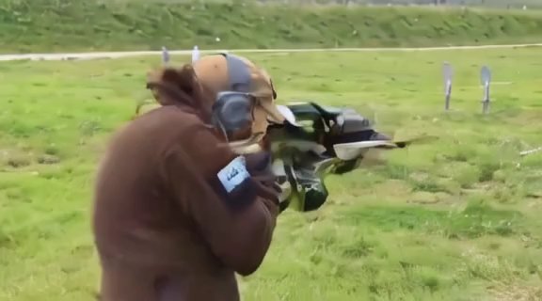
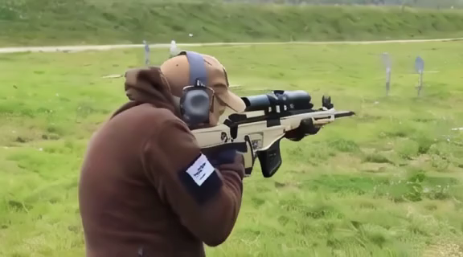
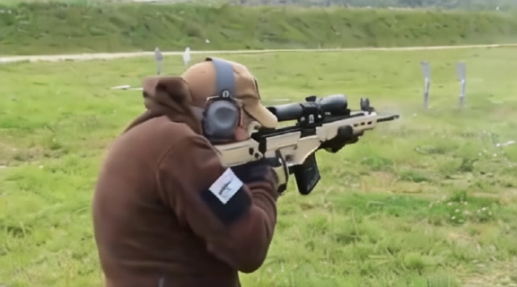
从图像生成同期声视频（对比效果）
image2video + Image2audio
image2video + video2audio
Ours: image2video&audio
Notes:
做完这个工作，我的研究生说为什么一定要先生成视频再配音呢？人类拍摄有声电影时最简单的方法是同期声。于是我们开始尝试以一张图片为输入，一次生成视频和音频。这里给大家展示几个例子。第一列，是用

Slide 41
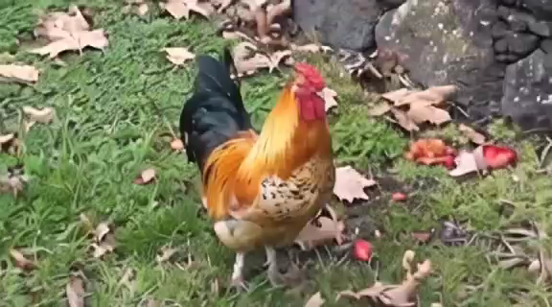



从图像生成同期声视频（更多例子）

Slide 42
图灵测试仍然是人工智能的最终目标吗？
图灵测试：问答形式，与人像（但超越也会觉得智能）
视频测试：视频形式，与物理世界像（但也允许想象）
人工智能的目标：造人&造世界
文学测试——绘画测试——电影测试——游戏测试
Notes:
最后，我在想生成视频生成有声的视频，除了也许可以提供一些影视制作的工具，还有什么意义让行业如此兴奋。我想是因为它突破了图灵测试，图灵测试看到的是造人，一个和人一样智能的AI；而视频测试，是在造世界，与包括人类的物理世界像不像？
有趣的是，大模型的发展似乎可以类比艺术创作的几种形式：
大语言模型写小说，类比与文学，质量显然与人类创作者有很大差距；
文生成图模型，类比与绘画，也是有形似神不似的感觉；
文生成视频，类比于电影测试，这个论坛讨论了很多；
下一步视频上的人是否可以真的与人交互起来，类比于游戏，已经看到一些工作，但还有巨大的空间。
但我相信，AI大陆有太多精彩的地方等着我们去探索，大家加油！

Slide 43
参考书目
吴飞，人工智能导论：模型与算法，高等教育出版社
马少平，朱小燕，人工智能，清华大学出版社
李航，智能与计算，中国计算机学会通讯，2019年第一期
尼克，人工智能简史，人民邮电出版社
Bergen B., Louder Than Words: The New Science of How the Mind Makes Meaning, Basic Books, 2012
Stuart J.Russell, Peter Norvig. Artificial Intelligence: a Modern Approach, Third Edition. Pearson Education Limited. 2016.
Richard S. Sutton and Andrew G. Barto. Reinforcement Learning: An Introduction. Second Edition. MIT Press, 2018

Slide 44
谢谢！

